Slide 1
Effects of Government Intervention-Price Control

Slide 2
Control on Prices
Controversy sometimes surrounds the prices and quantities established by demand and supply, especially for products that are considered necessities. In some cases, discontent over prices turns into public pressure on politicians, who may then pass legislation to prevent a certain price from climbing “too high” or falling “too low.”

Slide 3
Control on Prices
Price Ceiling
Price Floor
To support the consumers.
A legal maximum on the price of good at which a good can be sold.
To support the sellers
A legal minimum on the prices at which a good can be sold.

Slide 4
Price Ceiling
The National Pharmaceuticals Pricing Authority (NPPA)’s decision to create a ceiling for drug prices to keep them reasonably priced.
The role of NPPA is to fixes and revises the prices of essential drugs and monitors the prices of decontrolled drugs to keep them at reasonable levels.
Mira Shiva pointed out, “Nearly 80% of medical care costs have to be borne by patients out of pocket of which 70% is on medicines. Denial of essential life saving medicines due to lack of affordability and indebtedness is a harsh reality. A distorted market cannot and should not be the basis of drug pricing and policy, especially when the sale price has no bearing on the cost of production and purchasing power of our people.”

Slide 5

Figure 1 A Market with a Price Ceiling
(a) A Price Ceiling That Is Not Binding
Price of
Ice-Cream
Cone
Supply
€4
Price
ceiling
3
Equilibrium
price
Demand
0
100
Quantity of
Equilibrium
Ice-Cream
quantity
Cones

Slide 6
Figure 1 A Market with a Price Ceiling
(b) A Price Ceiling That Is Binding
Price of
Ice-Cream
Cone
Supply
Equilibrium
price
€3
2
Price
Shortage
ceiling
Demand
0
75
125
Quantity of
Quantity
Quantity
Ice-Cream
supplied
demanded
Cones
Copyright©2003 Southwestern/Thomson Learning

Slide 7
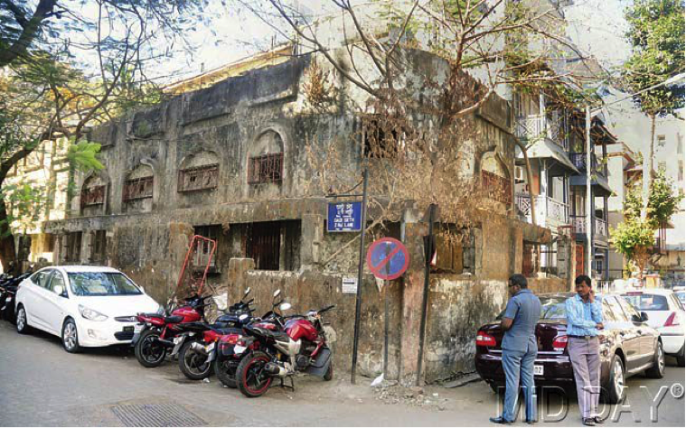



Slide 8
Rent Control Act in Mumbai
The ‘Bombay Rents, Hotel and lodging House Rates Control Act, 1947’ served its purpose in the short term but in the longer term it led to reduced supply of houses for rents, dilapidated houses, black income and reduced taxes to the government.
The ‘Bombay Rents, Hotel and lodging House Rates Control Act’ was introduced because of the acute shortage of houses in Bombay due to the world war and partition of colonial India. The purpose of the act was to prevent exploitation of the tenants and to prevent speculation. The prices were kept low to provide relief to the city’s migrants after the partition. It was supposed to benefit the tenants.
Under it, the state put a cap on the amount of rent a tenant paid to a landlord, and this amount remained virtually frozen irrespective of inflation and the consistent rise in the market rates over time. Rents at about 19,000 buildings were set at 1940 levels to prevent owners from charging excessive rates during a time of distress.

Slide 9
Figure 2 Rent Control in the Short Run and in the Long Run
(a) Rent Control in the Short Run
(supply and demand are inelastic)
Rental
Price of
Apartment
Supply
Controlled rent
Shortage
Demand
0
Quantity of
Apartments
Copyright©2003 Southwestern/Thomson Learning

Slide 10
Figure 2 Rent Control in the Short Run and in the Long Run
(b) Rent Control in the Long Run
(supply and demand are elastic)
Rental
Price of
Apartment
Supply
Controlled rent
Shortage
Demand
0
Quantity of
Apartments
Copyright©2003 Southwestern/Thomson Learning

Slide 11
Impact of Price Ceiling
When the government imposes a binding price ceiling on a competitive market, a shortage of good arises and sellers must ration the scarce goods and among the large number of potential buyers.
Rationing mechanism
Long lines
Discrimination

Slide 12
Price Ceiling on Knee Replacement
Type of Implants for Total Knee Replacement | Average MRP earlier | Average Price Reduction | New Ceiling Price and MRP (Rs)
The Standard and the most widely used complete knee implant (Cobalt, Chromium) | 1,58,324 | 65% | 54,720+GST
Special Metal like Titanium and Oxidised Zirconium | 2,49,251 | 69% | 76,600+GST
High Flexibility implant | 1,81,728 | 69% | 54,490+GST
Revision implants for Second surgery | 2,76,869 | 59% | 1,13,950+GST

Slide 13
NPPA 2022
The National Pharmaceutical Pricing Authority (NPPA) on 15th September 2022, extended the ceiling price it imposed on orthopaedic knee implants for knee replacement system in August, 2017, to one more year from September 16, 2022.
NPPA earlier in 2017 had fixed the ceiling price of orthopaedic knee implants for a period of one year. This was extended for further one year in 13th August 2018 and then on 15th August 2019. The above period ended on 15th August 2020 and the ceiling prices for knee implants for knee replacement system was due for review by 15-Aug-2021 and it was extended till 15th September 2022 which is now being extended for another one year.
All manufacturers of knee Implants, selling branded or non-branded or both versions of implants at prices higher than the ceiling price (plus goods and services tax as applicable) so fixed and notified by the Government, shall revise the price of all such implants downward not exceeding the ceiling price specified in its earlier notification.

Slide 14
Indian Steel Industry
Indian Steel Industry JSW steel,Tata Steel Ltd,Jindal steel and power,and Kalyani steels
Indian Steel Manufactureshave been lobbying the government to take more steps to protect their margins after a hike in the import duty last year failed to cut shipments from China.
The duty on various steel products ranges between $341 per tonne and $752 a tonne, the government said in a statement
China
Japan
South Korea
Imports of steel surged by 22.8 percent in 2015
China Produces half the world’s total 1.6 billion tonnes and exports 100 million tonnes {2014}
India is the third largest steel producer in the world with a total installed capacity of 110 million tonnes.

Slide 15
Figure 3 A Market with a Price Floor
(a) A Price Floor That Is Not Binding
Price of
Ice-Cream
Cone
Supply
Equilibrium
price
€3
Price
floor
2
Demand
0
100
Quantity of
Equilibrium
Ice-Cream
quantity
Cones
Copyright©2003 Southwestern/Thomson Learning

Slide 16
Figure 3 A Market with a Price Floor
(b) A Price Floor That Is Binding
Price of
Ice-Cream
Cone
Supply
Surplus
€4
Price
floor
3
Equilibrium
price
Demand
0
80
120
Quantity of
Quantity
Quantity
Ice-Cream
demanded
supplied
Cones
Copyright©2003 Southwestern/Thomson Learning

Slide 17
Figure 4 How the Minimum Wage Affects the Labour Market
Wage
labour
Supply
Equilibrium
wage
labour
demand
0
Equilibrium
employment
Quantity of
labour
Copyright©2003 Southwestern/Thomson Learning

Slide 18
Figure 4 How the Minimum Wage Affects the Labour Market
Wage
labour
Supply
labour surplus
(unemployment)
Minimum
wage
labour
demand
0
Quantity
demanded
Quantity
supplied
Quantity of
labour
Copyright©2003 Southwestern/Thomson Learning

Slide 19
Minimum Wages in India
As per the Indian Constitution, 'Minimum Wage' has been defined as the level of income for skilled and unskilled workers which ensures a sustaining standard of living while also providing for some measure of comfort. A minimum wage not just supports the bare level of employment, but also seeks for viable continuous improvement. It aims at preventing exploitation of labour.

Slide 20
Tamil Nadu Minimum wages for Domestic Help
Tamil Nadu government has fixed minimum monthly wages for domestic workers.
– Rs 37 for unskilled domestic workers, Rs 39 for skilled workers and Rs 38 for semi-skilled workers. The rates are fixed by considering a day’s chore of eight hours.
The minimum monthly wage for the entire day’s work for unskilled workers has been fixed at Rs 6836, whereas the same for qualified home nurse has been set at Rs 8051. For the workers who stay with their employers, the remuneration is 10% higher.

